Slide 1
Simple Real time Drawing Application
Presented by
Igben O. Nehemiah

Slide 2
Table of contents
Highlights of things learnt so far
Introduction of project
Project Flow
Implementation details

Slide 3
Highlights of things learnt during training
Basic C# programming
SOLID design pattern
Unit testing
Git
WPF
ORM (Fluent NHibernate, EFCore)
Asynchronous programming

Slide 4
Introduction to project
Login Window
Create Account Window
Startup Window
Menu
Right Pane
Create Project Window
Add Shared user
Shared Users
User Projects
Property window

Slide 5
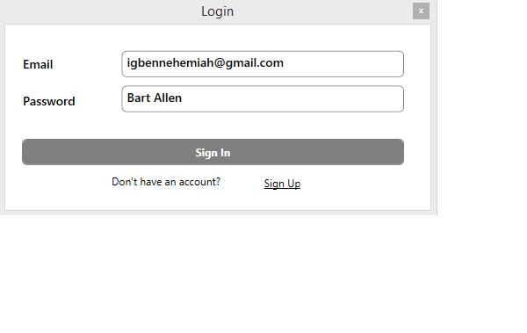
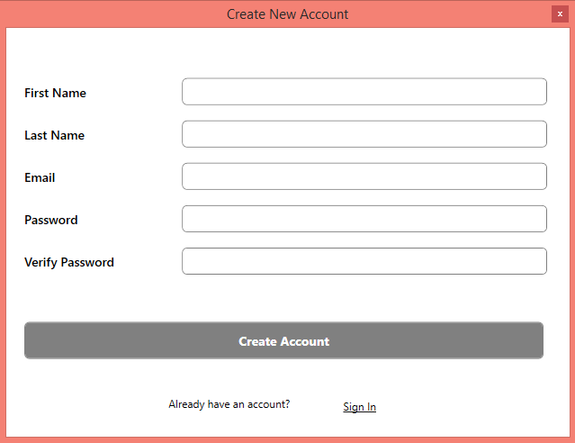
Introduction to project contd.

Slide 6
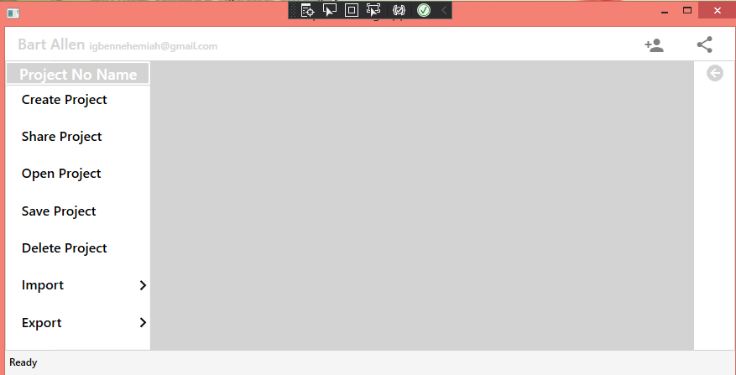
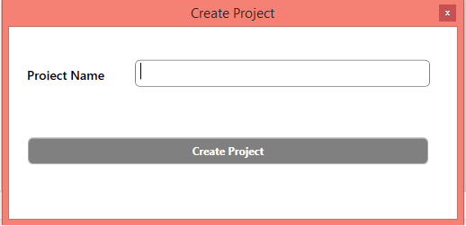
Introduction to project contd.

Slide 7
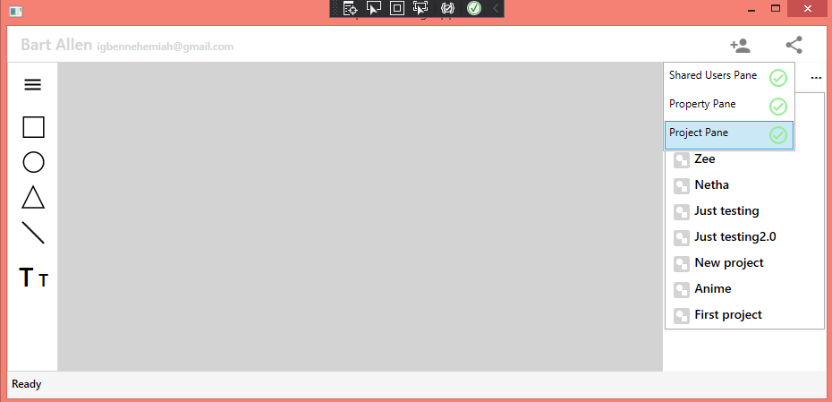
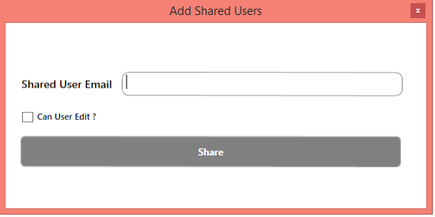
Introduction to project contd.

Slide 8
Project Flow
Common
Infrastructure
Models/Domain classes
WPFGraphicalUI (Main Project)

Slide 9
Common
Styles
Icons

Slide 10
Infrastructure
Repository
IRepository
I(ModelRepository)
I(ModelSpecificRepository)
ModelRepository

Slide 11
Infrastructure contd.
Unit of Work
IUnitOfWork
UnitOfWork
Drawing Application database context class

Slide 12
Model/Domain classes
User
Project
DrawingCanvasObject (pardon the name)
ProjectUser

Slide 13
WPFGraphicUserUI
Services
Views
ViewModels
Core
ModelProxies

Slide 14
Services
BrushConverterHelper (turns out brushConverter has already been taken)
ProxyToModelConverter
ModelToProxyConverters
DataAccessLayer

Slide 15
Views
Login view
Create Account View
Startup window view
Menu view
Right pane view
Shared users view
Projects view
Property view

Slide 16
View Models
Created for each view
View model for drawing canvas object that inherits from the default canvas

Slide 17
Thank You!

